Slide 1

ASSESSING SUPPLY CHAIN DISRUPTIONS AT INVISTA
MASTER OF SCIENCE IN BUSINESS ANALYTICS CAPSTONE PROJECT
Notes:
Nabeel Raheem

Slide 2

AGENDA
Project Overview
Date Quality Review
Data Analysis
Results
Recommendations
Nabeel Raheem
nabeelraheem35@gmail.com
Notes:
Nabeel Raheem

Slide 3
PROJECT OVERVIEW
Notes:
Nabeel Raheem

Slide 4



BUSINESS USE CASE
Opportunity:
Improve on-time material delivery with an eye to factors such as lead times, requested delivery times, and vendor confirmations.
Value: By reducing late deliveries and costs, the value would be between $500,000 and $1,000,000.
Success: Achieving success requires, understanding key influencers and accurate master data with updated lead times, providing transparency into vendor delivery performance, and consistently delivering materials on time, thus ensuring end-user confidence.
Notes:
Nabeel Raheem

Slide 5
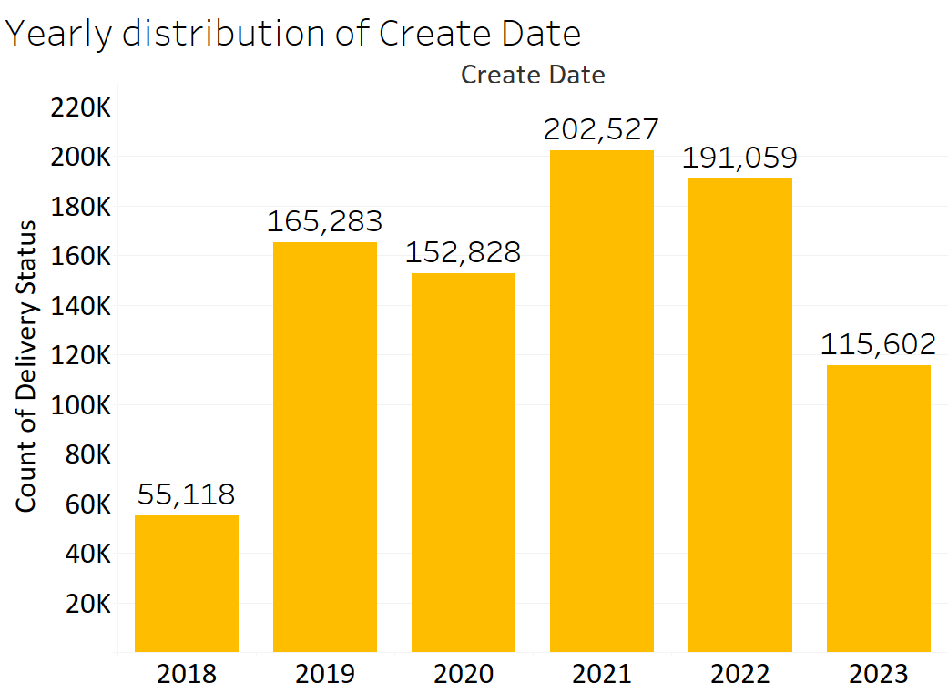
DATA SOURCE
6 Years of data from 09/07/2018-09/07/2023
1,139,407 Rows with 21 Columns
Notes:
Nabeel Raheem

Slide 6
DATA QUALITY
Notes:
Nabeel Raheem

Slide 7
DATA QUALITY OVERVIEW
Duplicates: 77,174 (6.7% of the whole dataset)
Data errors: Removed out-of-range date entries & Datatypes cleaning
Filters: The duplicate values of 55 and 71 in Purchase document ID were not dropped
865,149 cases after cleaning
Year | Delivery Date value counts
2002 - 2017 | 41
2018 | 56,978
2019 | 203,298
2020 | 182,319
2021 | 235,033
2022 | 215,971
2023 | 149,076
2024 - 2038 | 806
Notes:
Nabeel Raheem

Slide 8
MISSED AND DROPPED FEATURES
FEATURES | MISSING VALUES | DATA CLEANING
Vendor ID | 17.44% | Null values are dropped, Spaces are trimmed
Postal Code | 17.58% | Null values are dropped, Spaces are trimmed
POR Delivery Date | 70.60% | Null values are replaced with Requested Delivery Date
Sub Commodity Description | 0.03% | Special Characters are trimmed
MRP type ID | 49.54% | Feature is dropped
Release Date | 94.42% | Feature is dropped
MRP Type Description | 49.54% | Feature is dropped
Inbound Delivery ID | 59.63% | Feature is dropped
Notes:
Nabeel Raheem

Slide 9
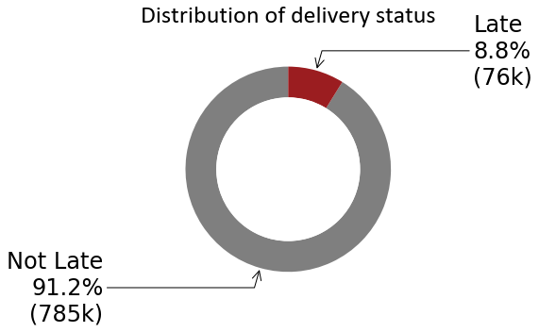
MAIN KPI
Not Late (0) vs Late (1): Delivery Date is greater than requested delivery date
Requested delivery date is either “POR delivery date” or “requested delivery date” – whichever is greater
Notes:
Nabeel Raheem

Slide 10
PROJECT SCOPE: INFLUENCERS
Order Creation Date (Day, Month, Year) : Correlation with seasonality
Plant ID: Compare plants, see which plants have more late deliveries
Company Code ID: The ID of the company from which the materials are being delivered into the plants of INVISTA.
Postal Code: The Postal Code of the vendor delivering materials to INVISTA.
Vendors ID: The ID of the vendor that delivers materials to INVISTA.
Material ID : The unique identifier for materials
Sub Commodity Description: This feature represents the type of material being delivered to the plants
Notes:
Nabeel Raheem
Responsible for Slide: Drake, Hilary
Hilary formatted it

Slide 11
DATA ANALYSIS
Notes:
Nabeel Raheem

Slide 12
FEATURE ENGINEERING
Seasonality
Company Code
Sub Commodity
Plant
Postal Code
Vendor
Notes:
Nabeel Raheem

Slide 13
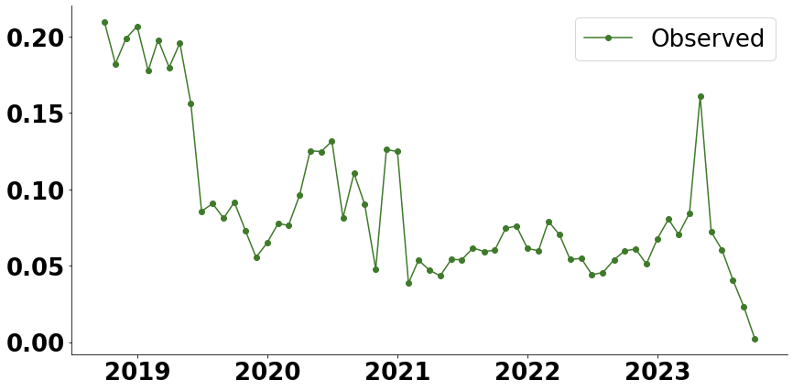
SEASONALITY: PERCENT LATE
Percentage Late Over Time
Overall percentage of late deliveries is decreasing, with the exception of a large spike in 2023
To explore in more detail, we looked at monthly averages
Notes:
Nabeel Raheem

Slide 14
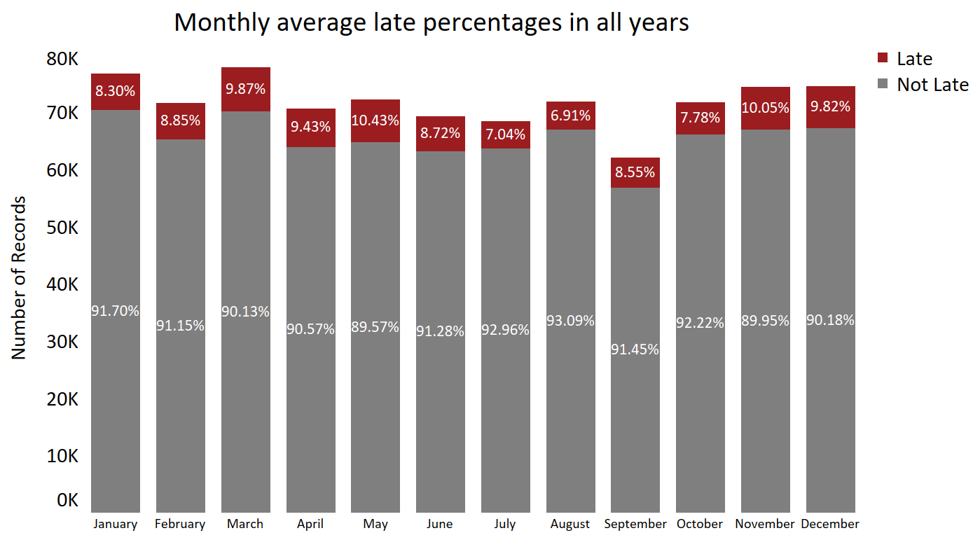
SEASONALITY: LATE DELIVERIES BY MONTH
8.3%
9.9%
10.0%
9.8%
8.9%
9.4%
10.4%
6.9%
7.8%
8.7%
7.0%
8.6%
Jan Feb Mar Apr May June July Aug Sep Oct Nov Dec
Notes:
Nabeel Raheem

Slide 15
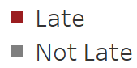
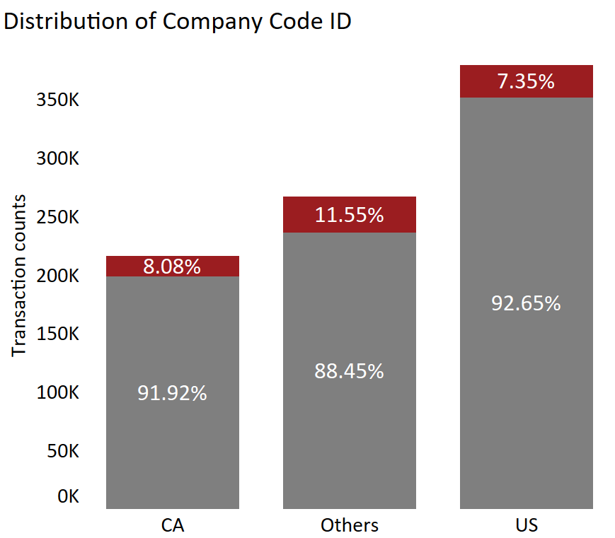
COMPANY CODE ID GROUPING
Category | No of Companies
CA | 1
US | 7
Others | 19
Notes:
Nabeel Raheem

Slide 16
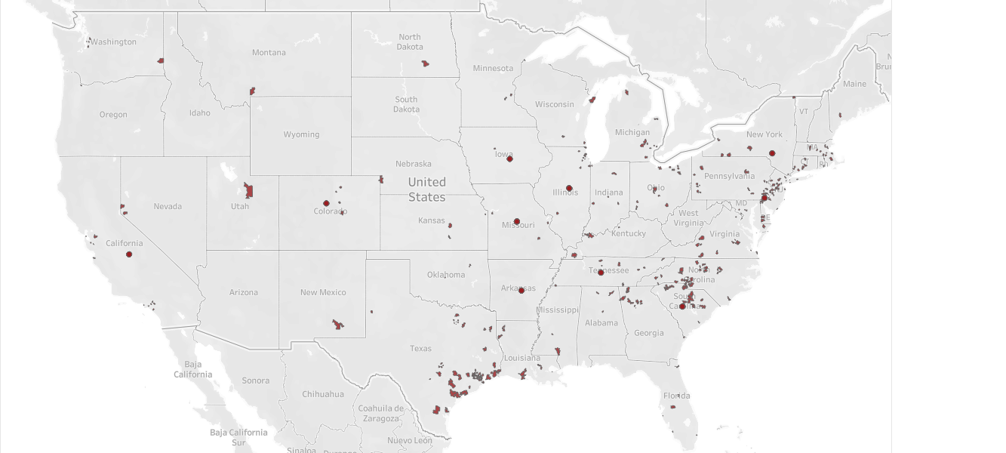
POSTAL CODE
Notes:
Nabeel Raheem

Slide 17
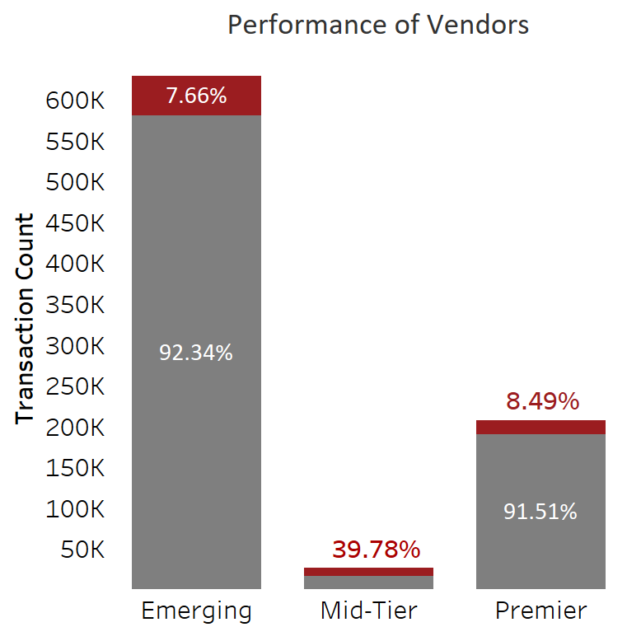
VENDOR CLUSTER
Category | Description | Vendors Count
Emerging Vendor Cluster | Vendor having less transactions | 5102
Mid-Tier Vendor Cluster | Vendors having average transactions rate | 441
Premier Vendor Cluster | Top Vendors in terms of transaction | 3
Notes:
Nabeel Raheem

Slide 18
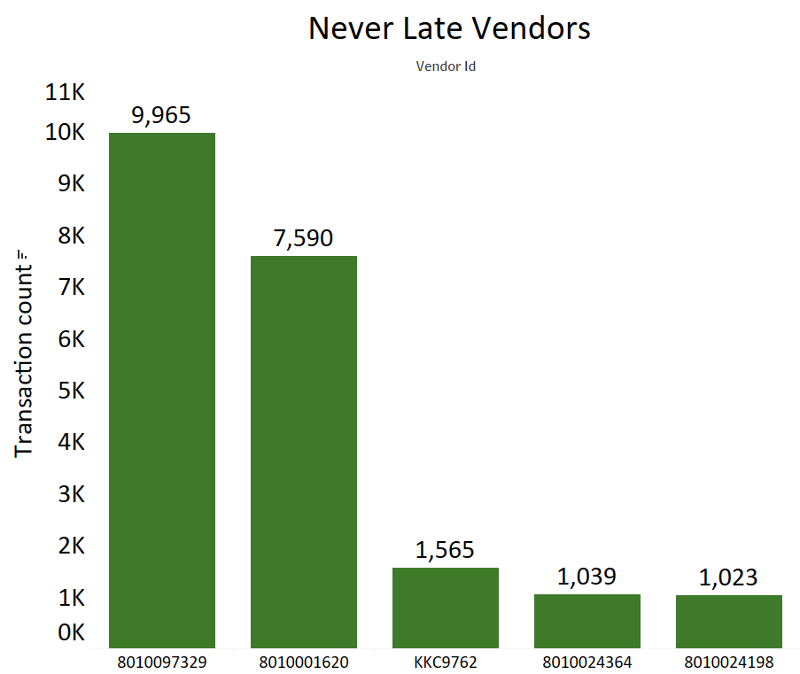
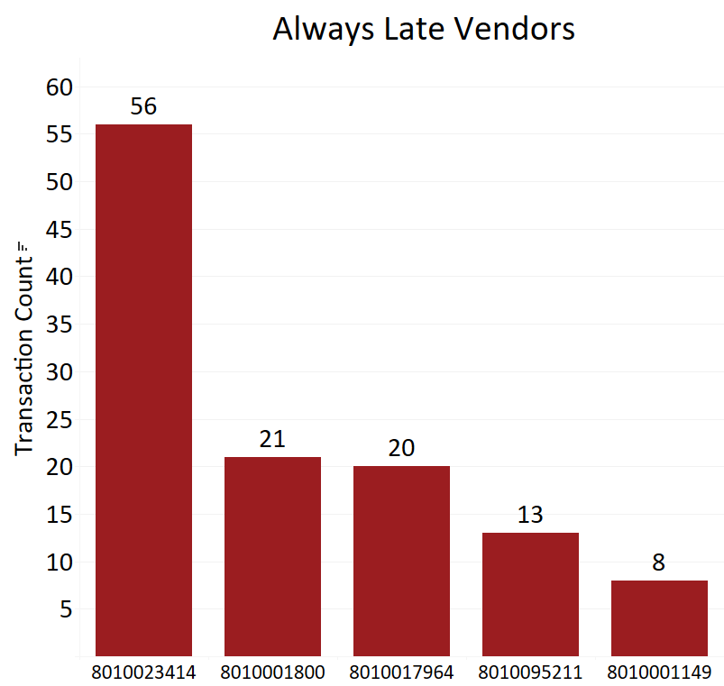
VENDORS PERFORMANCE
Never Late Vendors
Always Late Vendors
Notes:
Nabeel Raheem

Slide 19
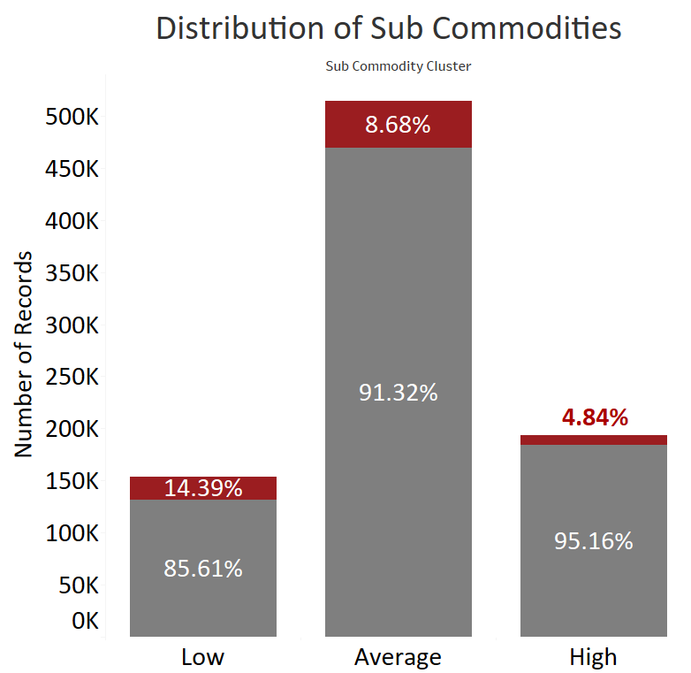
SUB COMMODITY CLUSTER
Category | Description | Count
Low performing Commodity Cluster | Unique commodities clustered in low-performing cluster | 15
Average performing Commodity Cluster | Unique commodities clustered in average-performing cluster | 10
High performing Commodity Cluster | Unique commodities clustered in high-performing cluster | 28
Notes:
Nabeel Raheem

Slide 20
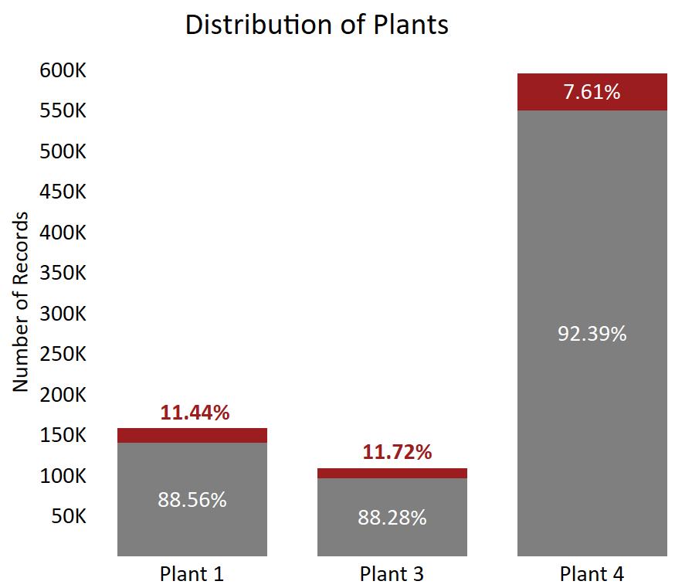
PLANT ID GROUPING
Category | Description | No of Plants
Plant 1 | Plant Id starting with 1 | 18
Plant 3 | Plant Id's starting with 3 | 30
Plant 4 | Plant Id's starting with 4 | 74
Notes:
Nabeel Raheem

Slide 21
FINDINGS
Notes:
Nabeel Raheem

Slide 22
METHODOLOGY
Logistic Regression
What It Does: Helps us understand which factors influence outcomes, such as whether a delivery is late or on-time.
Why We Used It: Simple yet effective way to predict binary results, like a yes/no or true/false situation.
Extreme Gradient Boosting
What It Does: It starts with a base model and sequentially adds new models that correct the errors made by the previous models.
Why We Used It: It's powerful, handles varied data well, and avoids common mistakes, making our predictions more reliable.
Notes:
Nabeel Raheem

Slide 23
MODELING
Time Series Split
What it does: Time series split divides the dataset into training and test sets in a sequential manner, ensuring that the training set always precedes the test set in time.
Why We Used It: To ensure the temporal order is maintained, which is crucial for analysis
SMOTE Oversampling
What It Does: SMOTE creates synthetic samples for the minority class instead of simply duplicating existing ones.
Why We Used It: To balance the data and prevent overfitting of the model. Oversampling is carried out on training dataset only.
Notes:
Nabeel Raheem

Slide 24
RESULTS COMPARISON
Model | Train Accuracy | Test Accuracy
Logistic Regression | 64.9% | 93.7%
Extreme Gradient Boosting | 64.9% | 94.9%
Evaluation Metrics | Logistic Regression | Extreme Gradient Boosting
F1 Score | 0.14 | 0.33
Precision | 0.72 | 0.40
Recall | 0.08 | 0.28
Notes:
Nabeel Raheem

Slide 25
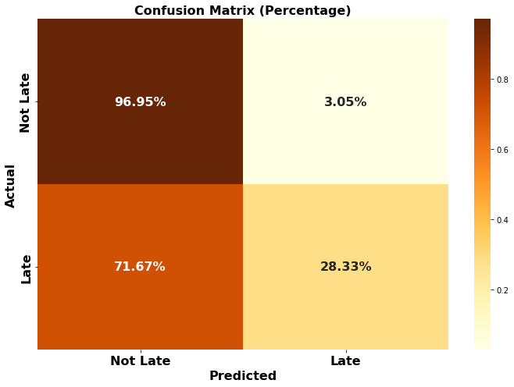
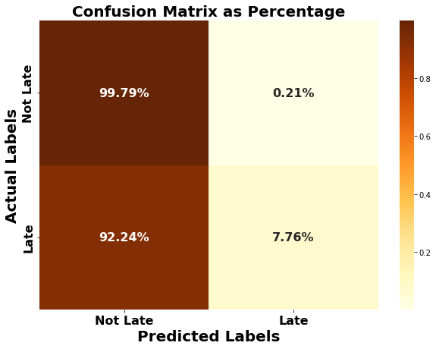
CONFUSION MATRIX
Extreme Gradient Boosting
Logistic Regression
Correctly Predicted as Not Late 97.95% | Incorrectly Predicted as Late 3.05%
Incorrectly Predicted as Not Late 71.67% | Correctly Predicted as Late 28.33%
Correctly Predicted as Not Late 99.79% | Incorrectly Predicted as Late 0.21%
Incorrectly Predicted as Not Late 92.24% | Correctly Predicted as Late 7.76%
Notes:
Nabeel Raheem

Slide 26
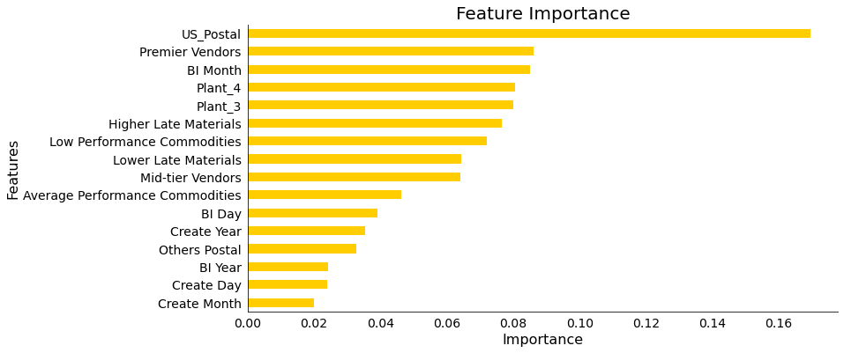
MOST IMPORTANT FEATURES
Notes:
Nabeel Raheem

Slide 27
INTERPRETATIONS - XGBOOST
FEATURES | DESCRIPTION
Vendor Cluster: Premier | 8010000984, 8010005836, V4036
US postal Codes | -
Plant 4 | 4036,4014,4124,4120,4040 and 71 Ids more
Plant 3 | 3009,3026,3024,3088,3076
Higher Late material cluster | 10 unique Material Id's
Average Material cluster | Id's in this cluster are 60% prone to late
Notes:
Nabeel Raheem

Slide 28
SUMMARY
Extreme gradient boosting has the best accuracy but more model refinement will help identify additional late vendors
Vendor, Plant, Postal Code, Material, and Sub Commodity are important influencers
Clusters were developed for these features to increase prediction accuracy
Other models we tested were able to identify additional significant features such as week, quarter, year, and vendor years of service
Notes:
Nabeel Raheem

Slide 29
USE CASE AND RECOMMENDATIONS
Notes:
Nabeel Raheem

Slide 30
USE CASES
Vendor Flagging: Use a ‘Vendor Flag' metric to generate a report that pinpoints suppliers who may be late for specific materials, locations, and sub-commodities, and perform root cause analysis on issues.
Alternate Vendor: Proactively target suppliers that are predicted to be late for certain materials by contacting suppliers early to confirm delivery date and change supplier if needed based on recommendations.
Vendor Selection: For materials with multiple vendors, use multivariate model output to optimize the selection of vendors with best performance.
Vendor Managed Inventory: For vendors who are significantly late, contact them about the option of doing VMI.
Notes:
Nabeel Raheem

Slide 31
SAMPLE REPORT - EXAMPLE
Expected Date | Company Code | Vendor Id | Postal Code | Material Id | Sub Commodity | Plant Id | Vendor Flag
2022-06-08 | US10 | 8010099066 | 98109 | 1100188070 | Safety Supplies | 4014 | Not Late
2023-09-07 | US10 | 8010003690 | 60055 | 4100003222 | Elements Industrial Gases | 4120 | Not late
2023-09-08 | US40 | 8010003297 | 19087 | 1100077867 | Lab Supplies | 4138 | Late
2023-08-23 | CA10 | 8010002499 | K7M5V7 | 1100117742 | Building Materials | 4036 | Not Late
2023-08-15 | CN16 | 8010018766 | 314006 | 3100001783 | Tubes cores | 1026 | Not Late
Notes:
Nabeel Raheem

Slide 32
SAMPLE REPORT SUPPLIER FLAGGING
The report accurately predicts if deliveries will be on time or late.
Shows clear examples of when specific materials from specific suppliers will be late, so steps can be taken to avoid issues.
Material Id | Vendor Id | Vendor flag | Alternate Vendor
4100002182 | 8010013628 | Late | 8010004740
4100002303 | 8010013641 | Late | 8010006527
Notes:
Nabeel Raheem

Slide 33



RECOMMENDATION SUMMARY
VENDOR FLAGGING REPORT
ALTERNATE VENDOR REPORT
ADDITIONAL ANALYSIS
Notes:
Nabeel Raheem

Slide 34
THANK YOU!
.
Notes:
Nabeel Raheem

Slide 35
APPENDIX
Notes:
Nabeel Raheem

Slide 36
VENDOR OPTIMIZATION
Have high transaction with 8010000984, 8010005836, V4036, V4014
Additionally, there are 79 vendors who are always late.
3,521 vendors are never late
Vendors | Total No of Transaction | Late Percentage
8010000984 | 98,436 | 7.13%
8010005836 | 69,594 | 8.05%
V4036 | 39,091 | 12.64%
V4014 | 24,850 | 11.00%
Notes:
Nabeel Raheem

Slide 37
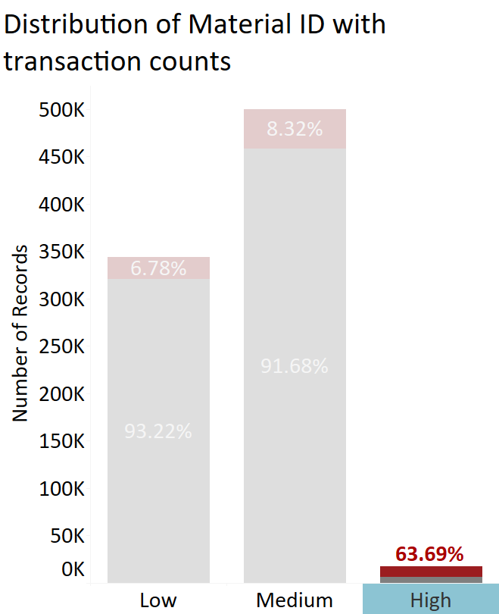
ORDER MANAGEMENT
Materials having the below Id's are more prone to late
2500001543
3100006153
2500001542
2500001568
2500005119
Ordering these materials upfront can improve the supply chain efficiency and inventory management
Notes:
Nabeel Raheem

Slide 38
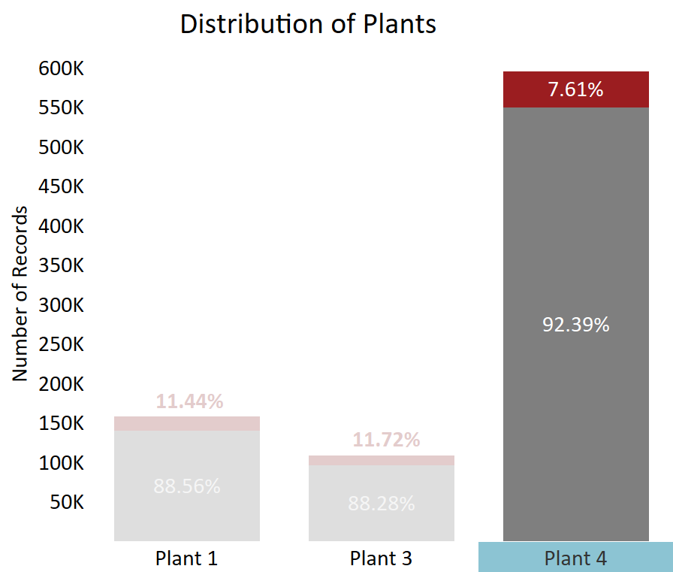
RCA FOR PLANT ID
4036,4014,4124,4120,4040 and 71 more plants prone to getting delayed
Conducting a root cause analysis in these plants will help identifying the issue for late deliveries.
Location of these plants can be used for further analysis
Notes:
Nabeel Raheem

